Slide 1

DHARANI.S
Final Project
1

Slide 2

Face Mask Detection Using Deep Neural Network
2

Slide 3



AGENDA
The face mask detection project begins with a clear definition of objectives, scope, and team roles. Diverse datasets of face images are collected and meticulously prepared through preprocessing and augmentation to ensure robust model training. Deep learning models, chosen for their suitability, undergo transfer learning with pre-trained architectures to expedite development and improve performance. Through rigorous evaluation, including validation metrics, the model's efficacy is assessed before deployment in various environments such as mobile apps or web services, where thorough testing ensures functionality. Comprehensive documentation is compiled, encompassing project processes, outcomes, and user manuals, while maintenance procedures are established to ensure ongoing updates and monitoring of the deployed model, cementing its role in supporting public health efforts during the COVID-19 pandemic.
3

Slide 4

PROBLEM STATEMENT
Develop a real-time face mask detection system using deep learning.
Analyze webcam video streams to identify faces.
Classify detected faces as wearing masks or not, aiding in enforcing safety regulations and promoting public health during the COVID-19 pandemic.
4

Slide 5

PROJECT OVERVIEW
Objective: Develop a real-time face mask detection system using deep learning to aid in enforcing safety regulations during the COVID-19 pandemic.
Methodology: Utilize pre-trained models for face detection and face mask detection to analyze webcam video streams in real-time.
Implementation: Draw bounding boxes around detected faces and classify them as wearing masks or not based on the classification results.
Expected Outcome: Deliver a robust and efficient system capable of accurately identifying individuals wearing masks in various environments.
Impact: Contribute to public health efforts by promoting adherence to mask-wearing guidelines and enhancing safety in public spaces.
5

Slide 6

WHO ARE THE END USERS?
Public Safety: Face mask detection systems aim to enhance public safety by alerting individuals and authorities when someone is not wearing a mask in public spaces.
Compliance Enforcement: These systems assist businesses, transportation authorities, and event organizers in enforcing mask mandates, ensuring adherence to health regulations and reducing the risk of COVID-19 transmission.
Healthcare Facility Support: Face mask detection systems help healthcare facilities maintain infection control measures by ensuring that everyone entering the facility wears a mask, thus protecting healthcare workers and patients.
Government Initiatives: Government agencies deploy these systems as part of broader public health initiatives to combat the spread of COVID-19, supporting efforts to enforce mask policies in public spaces.
Surveillance and Monitoring: Security personnel utilize face mask detection systems for surveillance and monitoring purposes, helping identify individuals who are not complying with mask regulations in various settings to ensure overall safety and security.
6

Slide 7

YOUR SOLUTION AND ITS VALUE PROPOSITION
Advanced Detection Technology: Our system utilizes state-of-the-art computer vision techniques to accurately identify individuals not wearing masks in real-time, providing immediate alerts.
Efficient Compliance Enforcement: Businesses, transportation authorities, and event organizers benefit from streamlined enforcement of mask mandates, saving time and resources while ensuring adherence to health regulations.
Healthcare Facility Support: Healthcare settings benefit from stringent infection control measures, as our system automates mask compliance verification among staff, patients, and visitors, reducing the risk of nosocomial infections.
Government Compliance and Support: Aligned with government initiatives, our system assists in enforcing mask policies in public spaces, contributing to containment efforts and reducing strain on healthcare systems.
Seamless Integration and Scalability: Designed for easy integration into existing infrastructure, our solution offers flexibility and scalability, ensuring compatibility with diverse environments and facilitating expansion as needs evolve.
7

Slide 8

THE WOW IN YOUR SOLUTION
Unrivaled Accuracy and Speed: Our solution boasts cutting-edge computer vision technology, ensuring unparalleled accuracy in real-time detection of individuals without masks, with instantaneous alerts for swift action.
Seamless Integration: Effortlessly integrates into existing infrastructure and workflows, minimizing disruptions and allowing for rapid deployment across diverse sectors and industries.
Adaptability and Scalability: With a flexible architecture, our solution adapts to evolving needs, whether deployed in a single location or scaled up to cover multiple sites and regions, ensuring comprehensive coverage and effectiveness.
Holistic Approach: Beyond detection, our system offers comprehensive support for compliance enforcement, infection control in healthcare settings, and alignment with government initiatives, addressing various facets of the COVID-19 challenge.
Enhanced Safety and Compliance: By combining advanced technology with seamless integration and comprehensive support, our solution delivers an unparalleled level of safety, compliance, and efficiency, making it the ultimate tool in the fight against the pandemic.
3/21/2024 Annual Review
8

Slide 9
MODELLING
CNN Architecture
Pre-Trained Models
Transfer Learning
Training Procedure
Loss Function
Evaluation Metrics
Deployment
9

Slide 10
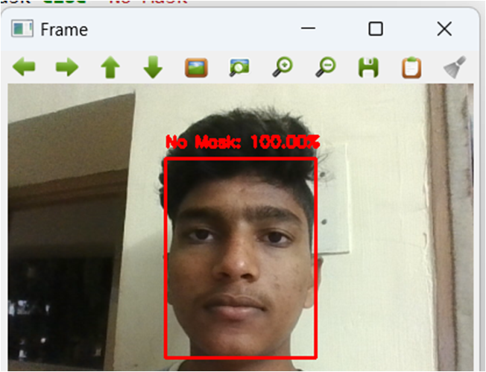
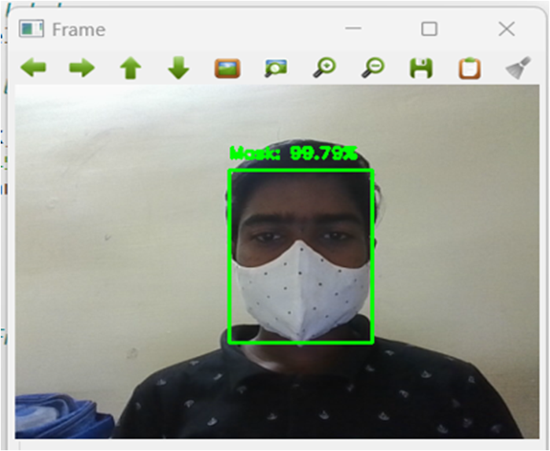
RESULTS
Without mask:
Withmask:
10

